Slide 1
Memory Hierarchy Chapter 2 & Appendix B
Vijayalakshmi

Slide 2
Since 1980, CPU has outpaced DRAM ...
Q. How do architects address this gap?
A. Put smaller, faster “cache” memories between CPU and DRAM.
Create a “memory hierarchy”.
Performance
(1/latency)
CPU
60% per yr
2X in 1.5 yrs
1000
CPU
100
Gap grew 50% per year
10
DRAM
9% per yr
2X in 10 yrs
DRAM
1980
1990
2000
Year

Slide 3

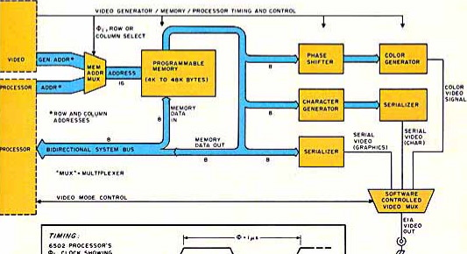
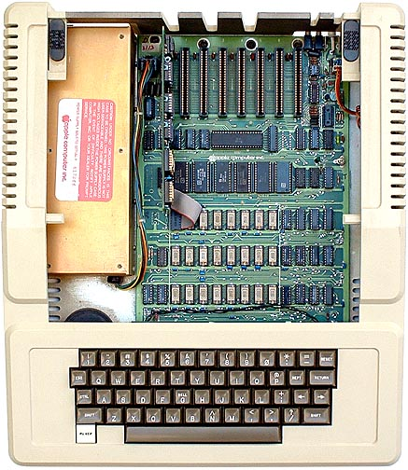


1977: DRAM faster than microprocessors
Apple ][ (1977)
CPU: 1000 ns
DRAM: 400 ns
Steve
Wozniak
Steve Jobs

Slide 4
Levels of the Memory Hierarchy
Capacity
Access Time
Cost
Upper Level
Staging
Xfer Unit
faster
CPU Registers
100s Bytes
<10s ns
Registers
Instr. Operands
prog./compiler
1-8 bytes
Cache
K Bytes
10-100 ns
1-0.1 cents/bit
Cache
Blocks
cache cntl
8-128 bytes
Main Memory
M Bytes
200ns- 500ns
$.0001-.00001 cents /bit
Memory
Pages
OS
512-4K bytes
Disk
G Bytes, 10 ms (10,000,000 ns)
10 - 10 cents/bit
Disk
-5
-6
Files
user/operator
Mbytes
Tape
infinite
sec-min
10
Larger
Tape
Lower Level
-8

Slide 5


Memory Hierarchy: Apple iMac G5
Managed
by compiler
Managed
by hardware
Managed by OS,
hardware,
application
07 | Reg | L1 Inst | L1 Data | L2 | DRAM | Disk
Size | 1K | 64K | 32K | 512K | 256M | 80G
Latency Cycles, Time | 1, 0.6 ns | 3, 1.9 ns | 3, 1.9 ns | 11, 6.9 ns | 88, 55 ns | 10⁷, 12 ms
iMac G5
1.6 GHz
Goal: Illusion of large, fast, cheap memory
Let programs address a memory space that scales to the disk size, at a speed that is usually as fast as register access

Slide 6
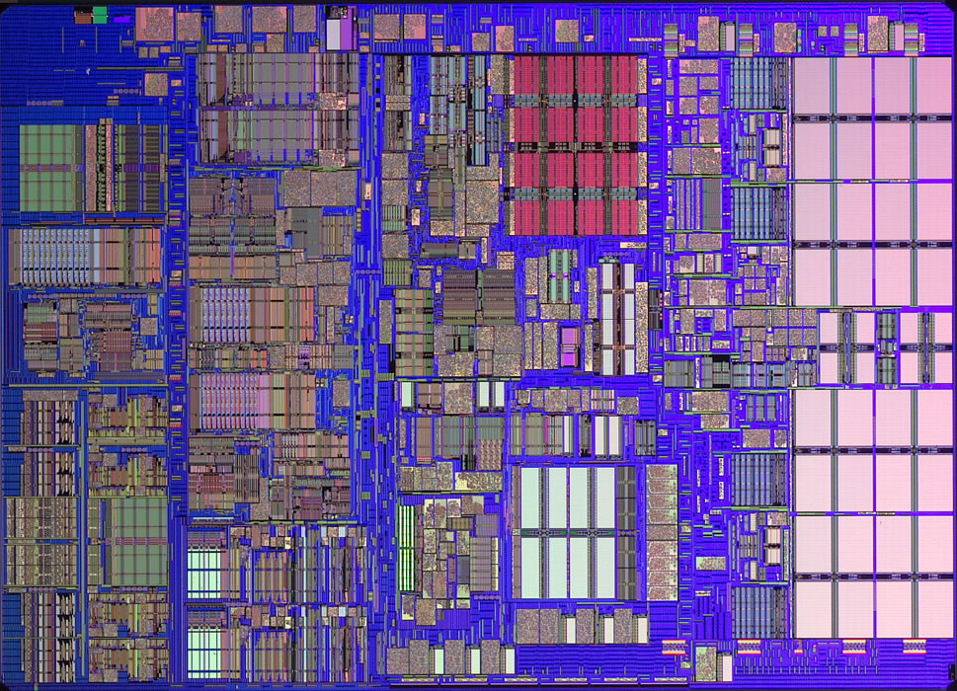
iMac’s PowerPC 970: All caches on-chip
L1 (64K Instruction)
Registers
512K
L2
(1K)
L1 (32K Data)

Slide 7
The Principle of Locality
The Principle of Locality:
Program access a relatively small portion of the address space at any instant of time.
Two Different Types of Locality:
Temporal Locality (Locality in Time): If an item is referenced, it will tend to be referenced again soon (e.g., loops, reuse)
Spatial Locality (Locality in Space): If an item is referenced, items whose addresses are close by tend to be referenced soon (e.g., straightline code, array access)
Last 15 years, HW relied on locality for speed
It is a property of programs which is exploited
in machine design.
Notes:
The principle of locality states that programs access a relatively small portion of the address space at any instant of time.
This is kind of like in real life, we all have a lot of friends. But at any given time most of us can only keep in touch with a small group of them.
There are two different types of locality: Temporal and Spatial. Temporal locality is the locality in time which says if an item is referenced, it will tend to be referenced again soon.
This is like saying if you just talk to one of your friends, it is likely that you will talk to him or her again soon.
This makes sense. For example, if you just have lunch with a friend, you may say, let’s go to the ball game this Sunday. So you will talk to him again soon.
Spatial locality is the locality in space. It says if an item is referenced, items whose addresses are close by tend to be referenced soon.
Once again, using our analogy. We can usually divide our friends into groups. Like friends from high school, friends from work, friends from home.
Let’s say you just talk to one of your friends from high school and she may say something like: “So did you hear so and so just won the lottery.”
You probably will say NO, I better give him a call and find out more.
So this is an example of spatial locality. You just talked to a friend from your high school days. As a result, you end up talking to another high school friend. Or at least in this case, you hope he still remember you are his friend.
+3 = 10 min. (X:50)

Slide 8
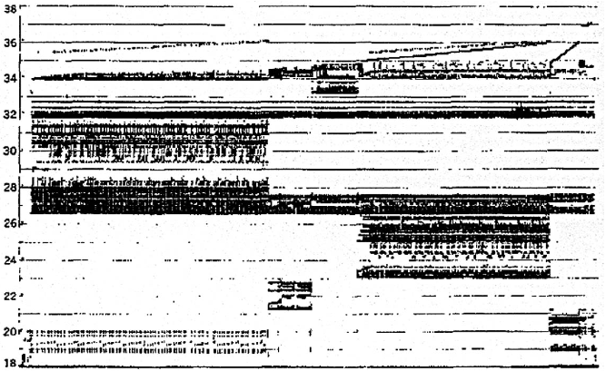
Programs with locality cache well ...
Bad locality behavior
Temporal
Locality
Memory Address (one dot per access)
Spatial
Locality
Time
Donald J. Hatfield, Jeanette Gerald: Program Restructuring for Virtual Memory. IBM Systems Journal 10(3): 168-192 (1971)

Slide 9
Memory Hierarchy: Terminology
Hit: data appears in some block in the upper level (example: Block X)
Hit Rate: the fraction of memory access found in the upper level
Hit Time: Time to access the upper level which consists of
access time + Time to determine hit/miss
Miss: data needs to be retrieve from a block in the lower level (Block Y)
Miss Rate = 1 - (Hit Rate)
Miss Penalty: Time to replace a block in the upper level
Hit Time << Miss Penalty
Lower Level
Memory
To Processor
Upper Level
Memory
Blk X
From Processor
Blk Y
Notes:
A HIT is when the data the processor wants to access is found in the upper level (Blk X).
The fraction of the memory access that are HIT is defined as HIT rate.
HIT Time is the time to access the Upper Level where the data is found (X). It consists of:
(a) Time to access this level.
(b) AND the time to determine if this is a Hit or Miss.
If the data the processor wants cannot be found in the Upper level. Then we have a miss and we need to retrieve the data (Blk Y) from the lower level.
By definition (definition of Hit: Fraction), the miss rate is just 1 minus the hit rate.
This miss penalty also consists of two parts:
(a) The time it takes to replace a block (Blk Y to BlkX) in the upper level.
(b) And then the time it takes to deliver this new block to the processor.
It is very important that your Hit Time to be much much smaller than your miss penalty. Otherwise, there will be no reason to build a memory hierarchy.
+2 = 14 min. (X:54)

Slide 10
Cache Measures
Hit rate: fraction found in that level
So high that usually talk about Miss rate
Miss rate fallacy: as MIPS to CPU performance, miss rate to average memory access time in memory
Average memory-access time = Hit time + Miss rate x Miss penalty (ns or clocks)
Miss penalty: time to replace a block from lower level
access time: time to lower level
= f(latency to lower level)
transfer time: time to transfer block
=f(BW between upper & lower levels)

Slide 11
4 Questions for Memory Hierarchy
Q1: Where can a block be placed in the upper level? (Block placement)
Q2: How is a block found if it is in the upper level? (Block identification)
Q3: Which block should be replaced on a miss? (Block replacement)
Q4: What happens on a write? (Write strategy)

Slide 12
Organization of Cache
Cache is like a table
Row corresponds to set
Set Index
0
1
2
3

Slide 13
Organization of Cache
Cache is like a table
Row corresponds to set
Column corresponds to associativity
Associativity = 1 => Direct mapped cache
Fully associative => Only 1 row
Cache Block
Set Index
0
0
1
2
…
N-1
1
2
3

Slide 14
Q1: Where can a block be placed in the upper level?
Block 12 placed in 8 block cache:
Fully associative, direct mapped, 2-way set associative
Set Index = Block Number Modulo Number Sets
Fully Assoc
Direct Mapped
(12 mod 8) = 4
2-Way Assoc
(12 mod 4) = 0
0123
Cache
01234567
1111111111222222222233
01234567890123456789012345678901
Memory

Slide 15
Q2: How is a block found if it is in the upper level?
Address
Block Address
Block
Offset
Tag
Index
# of bits =
Log(cache block size)
Tag on each block
No need to check index or block offset
Increasing associativity shrinks index, expands tag

Slide 16
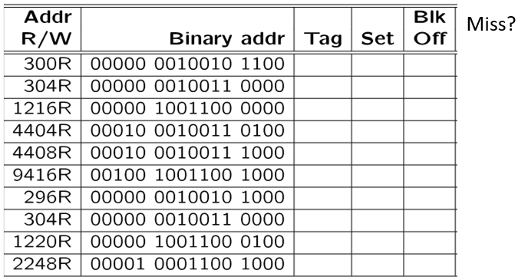
Direct Mapped Example
Assume 2KB cache with 16 bytes linesize and 1-way Associative:
How many blocks and how many sets(rows)?
How many bits for tag, set and block offset?
How much storage for tags(32-bit addresses)?
Question: How many cache misses will occur with the above memory access sequence ?

Slide 17
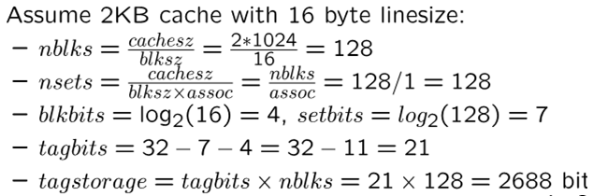
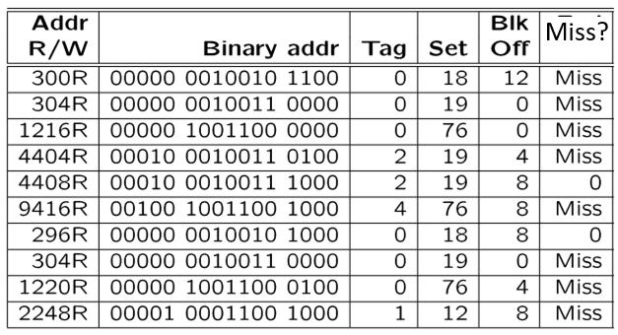
Direct Mapped Example
The miss explanation is on next slides.

Slide 18
Explanation of Cache Misses

Slide 19
Explanation of Cache Misses
10 references 8misses, 2 Hits

Slide 20
Q3: After a cache read miss, if there are no empty cache blocks, which block should be removed from the cache?
The Least Recently Used (LRU) block?
Appealing, but hard to implement for high associativity
2. A randomly chosen block?
Easy to implement, how well does it work?
Miss Rate for 2-way Set Associative Cache
Size | Random | LRU
16 KB | 5.7% | 5.2%
64 KB | 2.0% | 1.9%
256 KB | 1.17% | 1.15%
Also, try other LRU approx.

Slide 21
Q4: What happens on a write?
 | Write-Through | Write-Back
Policy | 1. Data written to cache block 2. also written to lower-level memory | 1. Write data only to the cache 2. Update lower level when a block falls out of the cache
Debug | Easy | Hard
Do read misses produce writes? | No | Yes(write when replace)
Do repeated writes make it to lower level? | Yes | No
Additional option -- let writes to an un-cached address allocate a new cache line (“write-allocate”).

Slide 22
Write Buffers for Write-Through Caches
Cache
Lower Level Memory
Processor
Write Buffer
Holds data awaiting write-through to
lower level memory
Q. Why a write buffer ?
A. So CPU doesn’t stall
Q. Why a buffer, why not just one register ?
A. Bursts of writes are
common.
Q. Are Read After Write (RAW) hazards an issue for write buffer?
A. Yes! Drain buffer before next read, or send read 1st after check write buffers.

